Slide 1


Data science
Prediction of crime in the states of USA

Slide 2


Data acquisition

Slide 3



Ideas:
Resources:
1. First idea - predict over booked flights:
Good idea, poor data and very expencive.
2. crime forecast in the unites states:
We loved the idea
Lots of information available
FBI: FEDERAL BUREAU OF INVESTIGATION
KFF: Kaiser Family Foundation

Slide 4

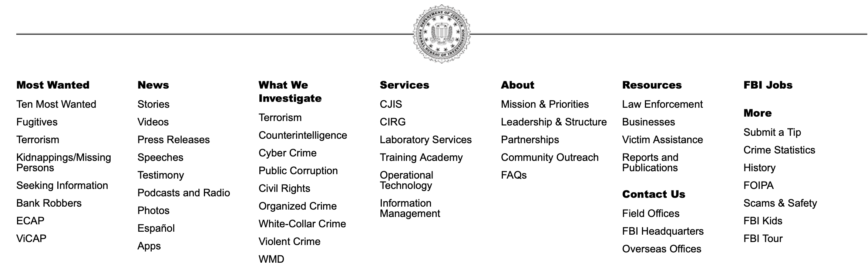
Where is what we’re looking for?

Slide 5
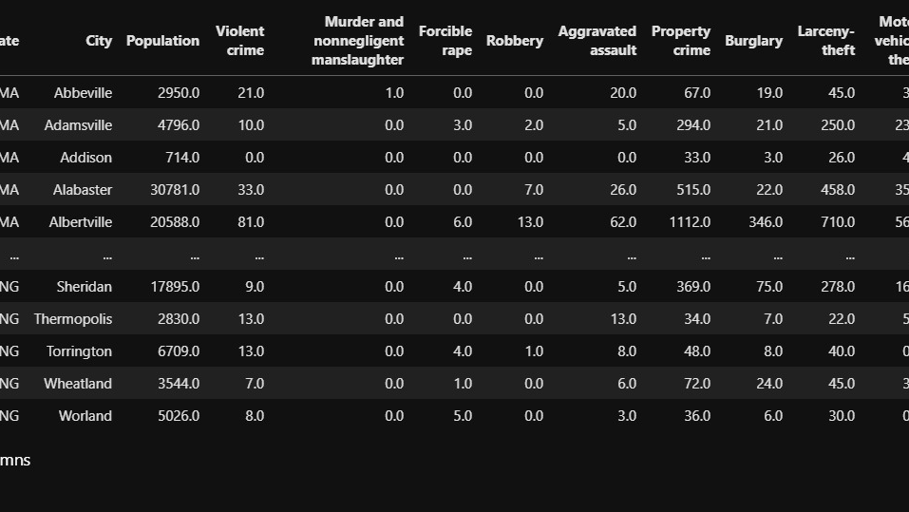

We found what we were looking for

Slide 6
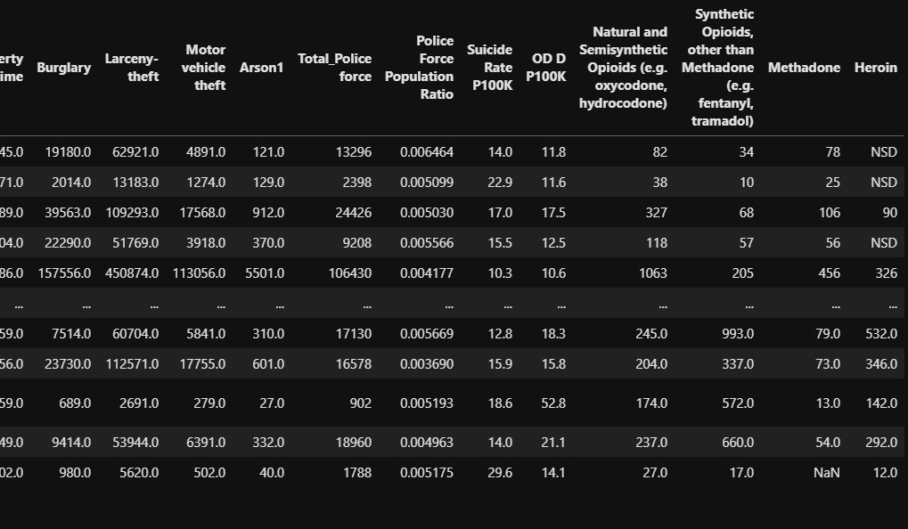
Now let’s clean it.
Merge it
Add missing data

Slide 7

How the numbers really look like:

Slide 8
Scatter:
We can see by this scatter the white population cases are spread across, while the black population rape cases are drastically arise.

Slide 9
In this heatmap and scatter we wanted to see if is there any indication of a Burglary and Robbery crimes based on a Citizenship Status. Although there is a high correlation we cannot determine whether Non-Citizen are making more Burglary and Robbery crimes.

Slide 10
Logic: higher the police population ratio leads to lower the crime?
This graph will describe the relation of total law enforcement over population.
We wanted to see if this relation may has a correlation to indicate whether high number of law enforcement results high crime numbers.
We took the max and min relation which resulted that District of Colombia has the highest relation and UTAH has the min relation.
We thought that high relation of law enforcement will yield low crime numbers, but according to the bar graph Colombia had higher crime rates than UTAH.
Therefore, we can conclude that high law enforcement numbers does not lower the crime rates.

Slide 11
Violin
Display relation between Republican / Democrat states in Murder crimes.
Most of the murder cases are concentrated around the median of the violin figures (White Dot).
We can see that the shape of the Republican violin differs a bit from the Democrat due to the fact there are more cases in the Republican states as opposed to Democrat.
We can also see the top of the Democrat violin is higher due a outlier.

Slide 12

Machine learning -Linear regression -Ridge model

Slide 13


Linear regression
We tried to build a few linear models for certain crimes: Assault, Vehicle theft and Property crime.
Our data was from years 2010-2019.
We build the model on 2010-2018, and predicted 2019 (deviation mean = ~2%)
Some were good and some were worse.
In the pictures below we evaluate R^2: 0.98.

Slide 14
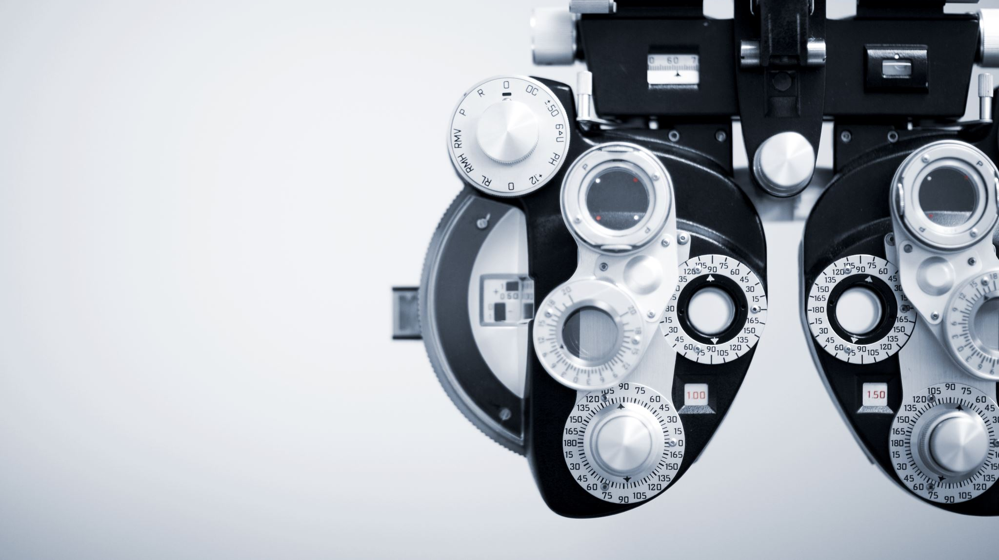
,
Our vision
Machine Learning insights

Slide 15
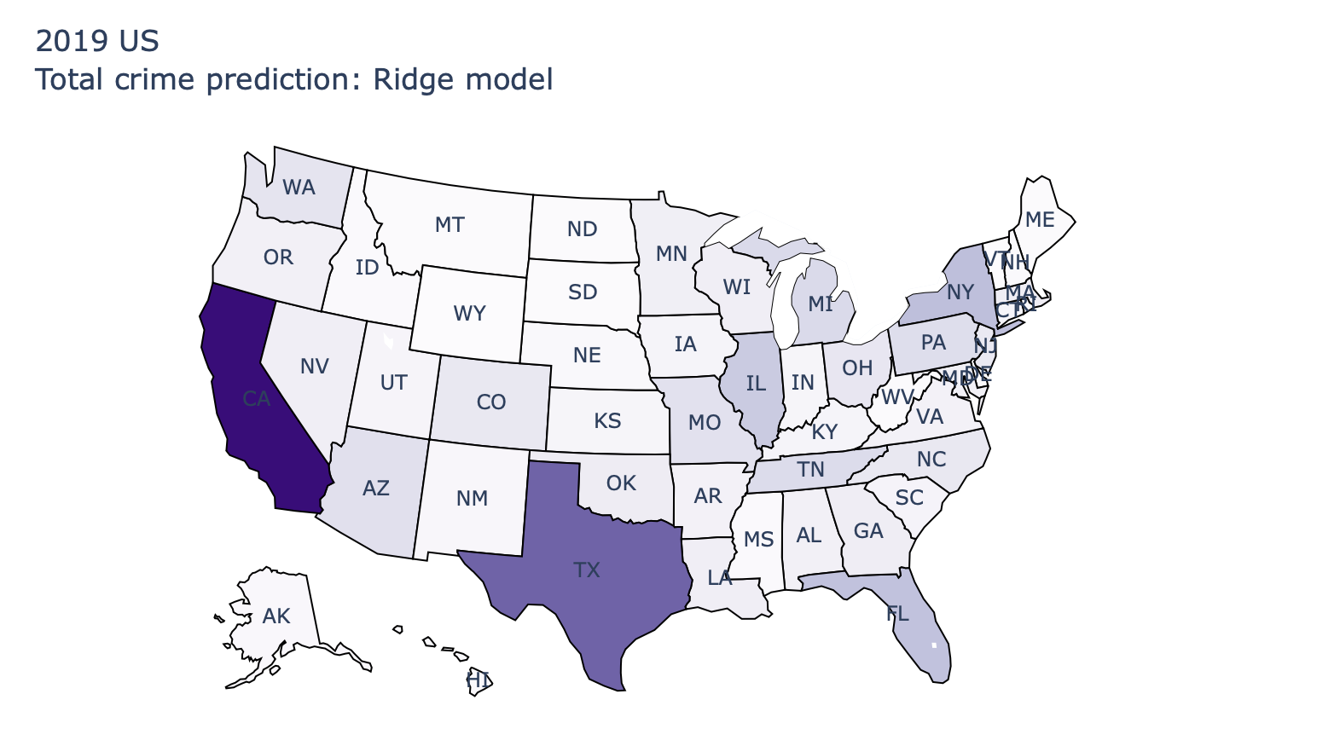
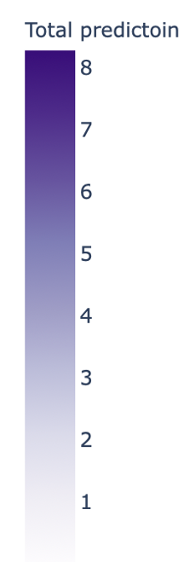
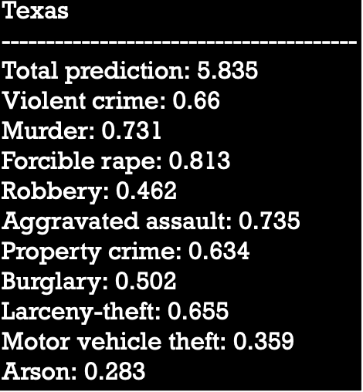

Slide 16
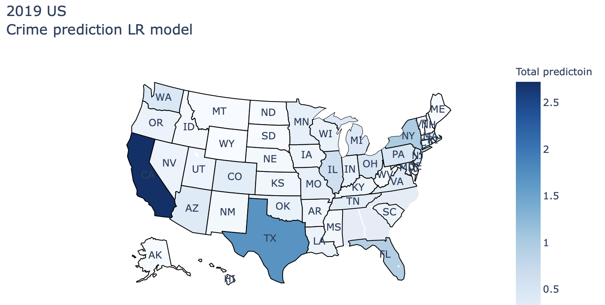
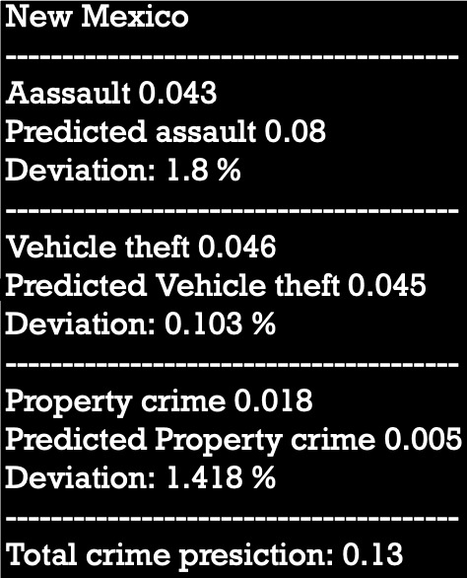

Slide 17

Conclusions:

Slide 18
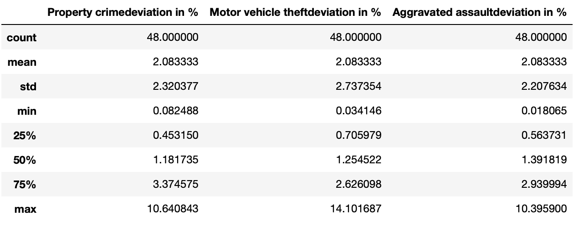
Results from linear regression DF:

Slide 19
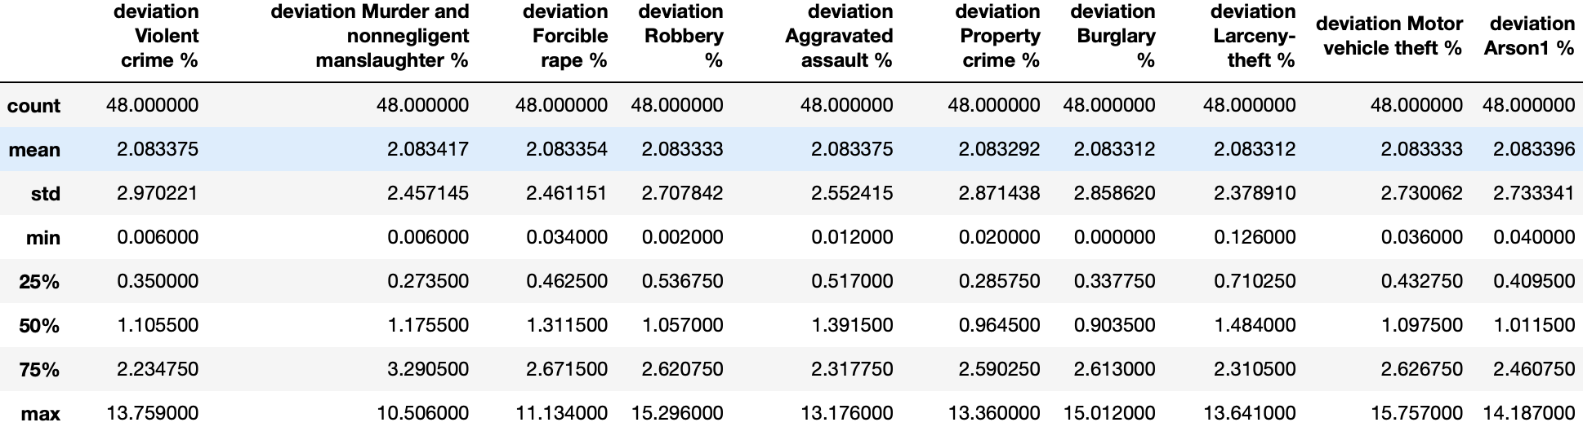
Results from Ridge:

Slide 20
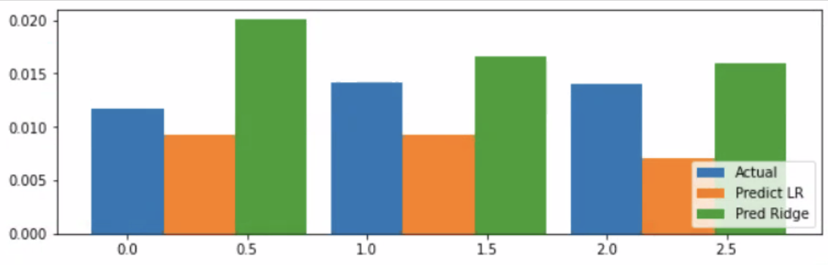
Compering Ridge and Linear regression Property crime, Aggravated assault, Motor theft
In the graph above, we compared between the two ML approches to see which one was closer to the actual numbers. With the combination of the last three slides it is safe to say that both were very close, but the Ridge is slightly less accurate.

Slide 21
What we conclude:
1. We have created the “Population Police ratio VS Crime rate” bar plot, we thought that the place with a larger police force will probably be "quiet". Surprisingly the conclusion from the plot was the opposite. It turned out that the place that had more police can be up to 4 times intended for calamity (district of Colombia VS Utah). Israel nowadays has much higher law enforcement deployed in the city of Jerusalem in contrast to Holon for example.
2. From the Machine Learning models we can learn few things. Given most of our features not purely related to crime and due to that, may not strengthen our ML models like formulas : ”Syphilis cases” X ”Suicide rate” , while-intercept+ coef X Feature + coef X Feature … will do.

Slide 22
Further more:
Comparing the 2 models: Ridge and classic Linear Regression we found out that upon choosing a good Linear Regression model with strong correlation features the result will be pretty much the same to the ridge which take all the df features.
Linear Regression Pros: It was relatively fast because we chose to work with a small highly correlated features we checked prior the model via heatmaps, and the label we wanted to predict, very fast and simple solution.
Linear Regression Cons: It took some work to find the right columns for the models, we had 100 columns to figure out what might produce good correlation.
Ridge Pros : Given it can become a hyperparameter model it gives a very accurate prediction for the task in an automatic way.
Ridge Cons : Took a lot of time to calculate in order to get an accurate prediction, so the computer CPU goes very high

Slide 23
Map Analysis:
If we would base our conclusion only by visualizing the US map we would have got a false conclusion.
By looking at the colors of the map it could seen like all the US is pretty quiet, while Texas and California are at the top of the crime table.
On the other hand, with a closer look at the map, and after analyzing the numbers, we can see that both states has a large deviation in their crimes, which leads to false visualization with Texas. (CA real crime numbers and not predicted actually distinct)

Slide 24
What we could add:
Explore Outside the United States: In this project we can explored only the US states. On the other hand, Analysis on crime all over the world is a challenge.
Cyber Crimes: Given Cyber crimes are increasing each year, it would have been nice to explore different kinds of attacks in the “Internet world”.
Hate Crimes: Hate crimes is interesting field of crime to explore. We could explore the hate crimes upon the following biases: 1) Race/Ethnicity/Ancestry 2) Religion 3) Sexual Orientation 4) Gender
Terrorism: Another great field that we can explore is Terrorism. We can explore different questions like: 1) Which country suffers the most of terror. 2) Which country the has the most terrorists exported.

Slide 25

Tips for next project:
Working with GIT: We only used it to upload the notebooks at the end of the project. (We should have learned the proper work in advanced)
Working with Dockers: As both of us have different OS systems and we both using different types of Notebooks (Jupeyter Lab and Anaconda Jupyter). We faced a lot of difficulties with library imports.
Local directories at the notebooks: We had to constantly change the directories in order to execute the notebooks

Slide 26

The end ☺

